Slide 1



Energy Consumption and
Trend Analysis

Slide 2

Learning Objectives
Analyze real-world energy consumption data using Power BI and Excel
Clean and preprocess data for accurate trend analysis
Extract meaningful time-based features (e.g., hour, day, month)
Create interactive dashboards and visualizations in Power BI
Interpret data patterns to identify peak usage and seasonal trends
Strengthen foundational data analysis and visual storytelling skills
GOAL
Source :
www.freepik.com/

Slide 3

Tools and Technology used
Power BI: For creating interactive dashboards and visualizing energy consumption trends
Microsoft Excel: Data cleaning, preprocessing, and initial exploration
Data Sources: Provided internal dataset
Freepik: Source for presentation graphics and icons

Slide 4


Methodology
Data Cleaning
Removed missing values and duplicates
Standardized date/time formats
Normalized energy units and column names
Feature Engineering
Extracted new time-based features:
Hour, Day, Month, Year, Weekday
Added peak/off-peak usage indicators
Visualization
Line plots for monthly/weekly trends
Bar charts for hour/day-wise usage
Heatmaps to show time-of-day patterns
Trend Analysis
Identified seasonal fluctuations and peak demand hours
Compared weekday vs weekend consumption behavior
Detected anomalies and unusual spikes
Insight Extraction
Summarized usage patterns
Provided recommendations for energy optimization

Slide 5

Problem Statement:
In many organizations and households, energy consumption data exists but is underutilized due to its raw and unstructured format.
Without proper trend analysis, decision-makers struggle to forecast demand or implement cost-saving measures effectively.
Key patterns like peak usage, seasonal spikes, or inefficiencies often remain hidden in spreadsheets and logs.
This lack of visibility leads to poor energy planning, unnecessary costs, and missed opportunities for optimization.

Slide 6

Solution:
A dynamic Power BI dashboard was created to transform complex energy data into interactive visual insights.
Consumption data was segmented by city, building, and time (year, quarter, month) to uncover localized usage trends.
Visualizations such as bar charts, line graphs and pie charts were used to highlight: Peak electricity, gas and water usage, Monthly consumption patterns across cities, Price-per-unit trends by energy type
Key Influencer analysis helped determine what factors drive consumption behavior.
The solution empowers stakeholders to monitor, compare and optimize energy use across multiple locations in real time.

Slide 7
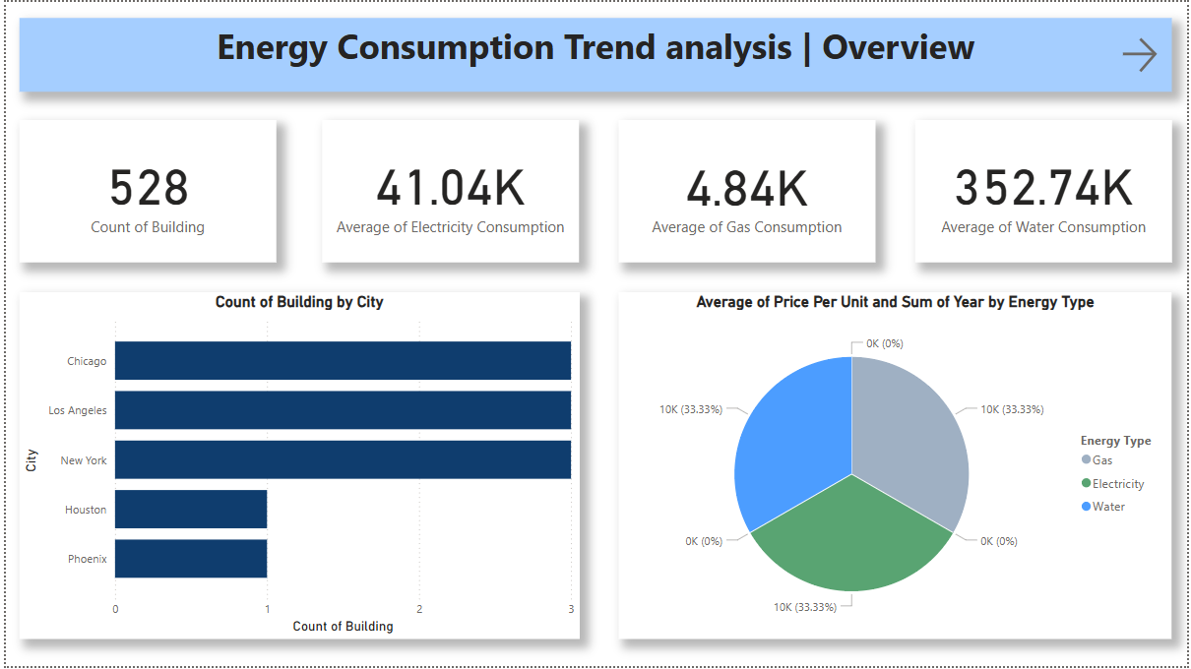
Screenshot of Output:
This Overview page summarizes key metrics like building count and average utility consumption. It shows how energy usage differs across cities and energy types. The Pie chart reflects the distribution of unit costs between electricity, gas and water. Together, these visuals give a high-level understanding of consumption behavior.

Slide 8
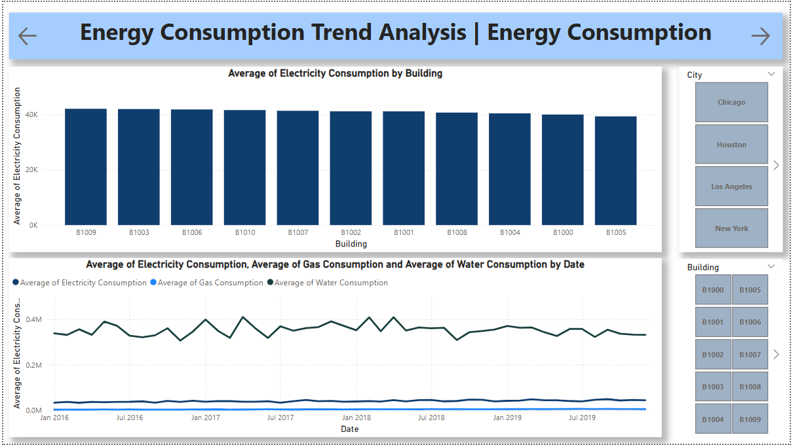
This dashboard compares average electricity consumption across different buildings and visualizes energy usage trends over time. It highlights consistent electricity demand, with relatively low gas and water usage. The timeline chart helps identify seasonal or yearly variations. Filters for city and building enable focused, location-specific analysis.

Slide 9
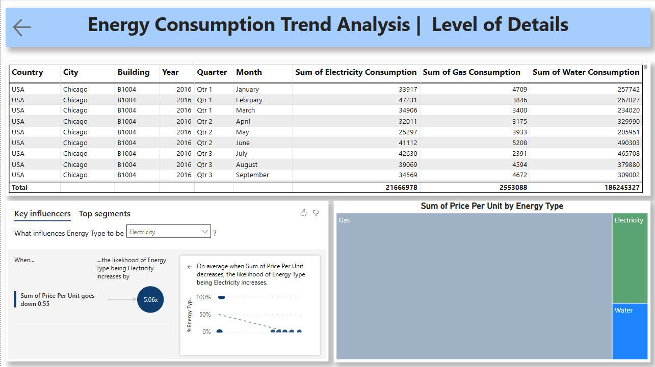
This page provides detailed monthly consumption data by building and city. It uses a key influencer analysis to reveal how price affects the choice of energy type, especially electricity. The tree map shows cost contribution by energy source. This level of insight supports data-driven decisions for energy planning.

Slide 10

Conclusion:
This project enabled the transformation of raw energy data into actionable insights using Power BI and Excel. It revealed key patterns such as seasonal usage spikes, peak consumption periods, and cost-impact relationships across cities and buildings. The visual dashboards made complex data easier to understand, helping in effective decision-making for energy optimization.
The project not only improved my skills in data visualization and analysis, but also demonstrated how such tools can support smarter resource management in real-world scenarios. It reinforced the value of data-driven planning for sustainable and efficient energy usage.

